Slide 1
Lab4 Complete Single Cycle CPU
Peter

Slide 2
Notice
Lab 4 is Group work
Please follow Group ID in cloud (https://reurl.cc/nzN58n)
Lab 4 will have individual Demo
Run your program in your computer
Run special test case in your computer (considering)
Code review
Ask questions
All of you need to submit to new e3, format: “GroupID_ID1_ID2.zip”
Deadline 2020/05/21
Notes:
Branch animation

Slide 3
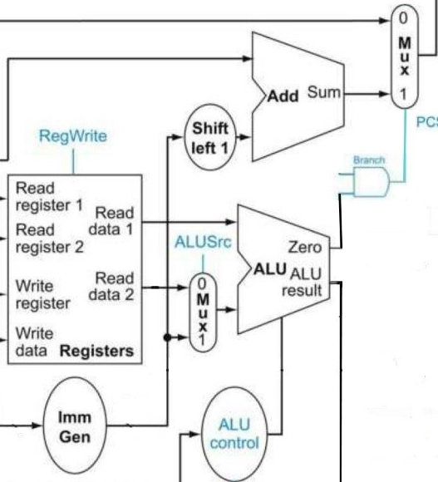
Reminder from Lab3
Branch ImmGen
Ex:
Beq r1, r2, 10 // 10 = 1010₂
0
000000
0101
0
//Signed extend to 32bit
0…0101₂ = 5
Shift Left 1
0…01010₂= 10

Slide 4
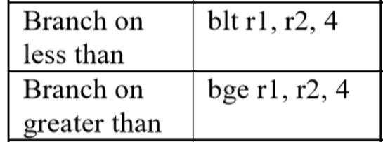
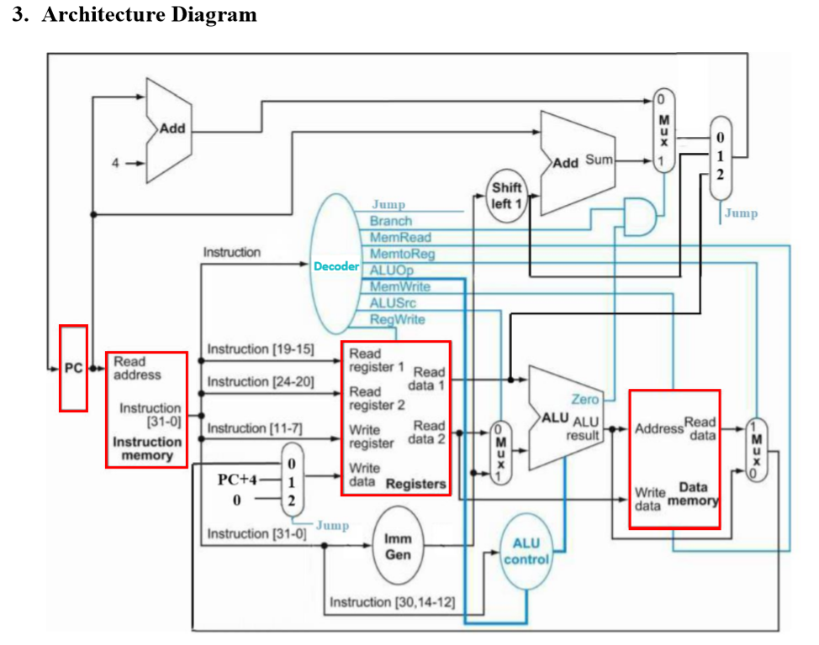
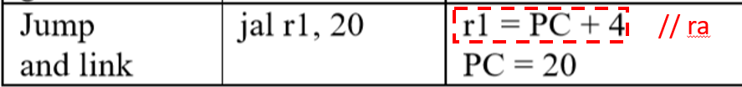
Architecture Diagram for Lab 4
Extend from Lab3, modify PCSrc, decoder, add DataMemory, Add Mux
Will be provided
Add on

Slide 5
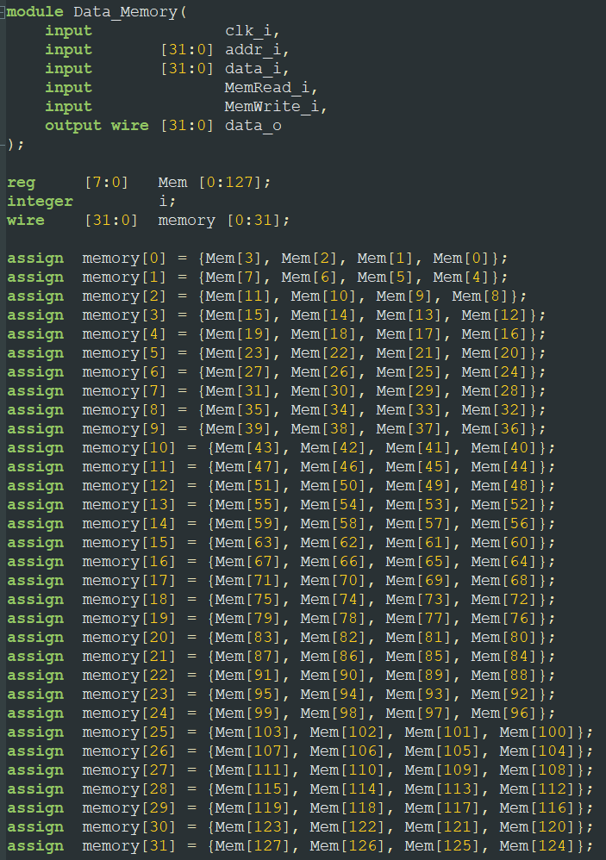
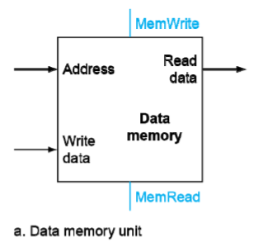
Data Memory(Provided)

Slide 6
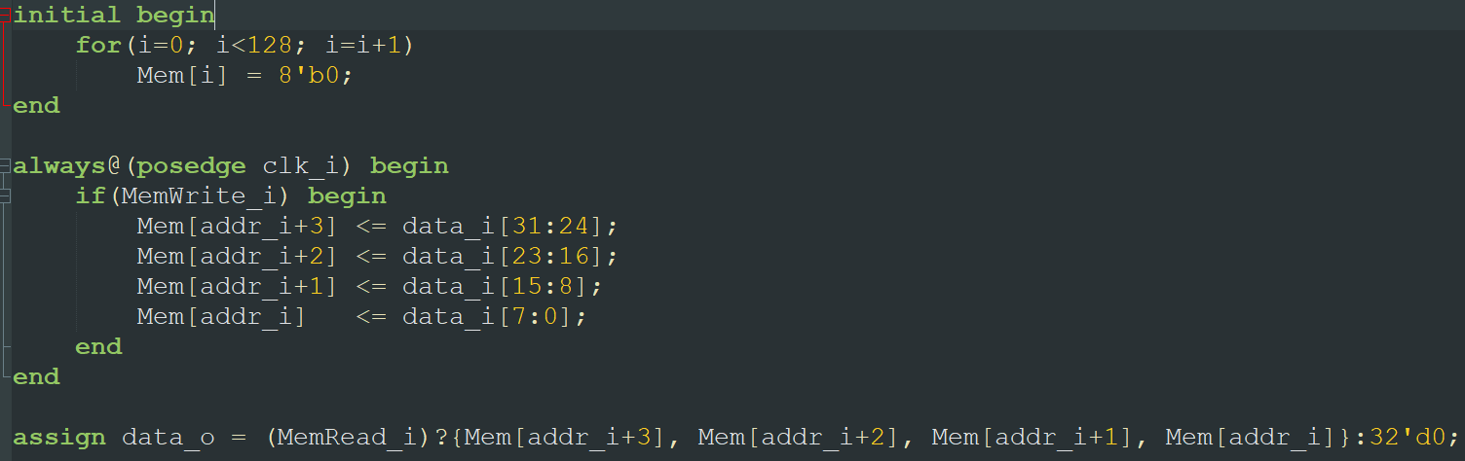
Load and Store instructions
Store instruction
Load instruction

Slide 7
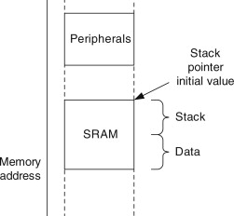
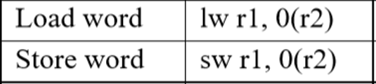
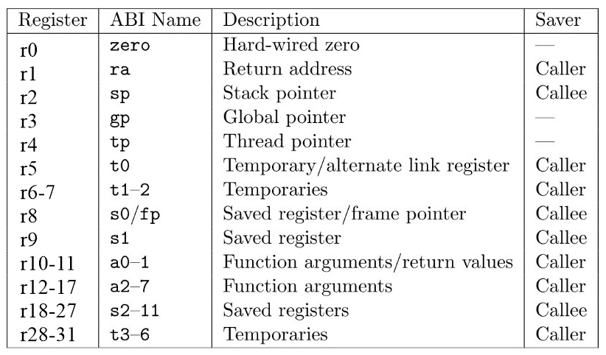
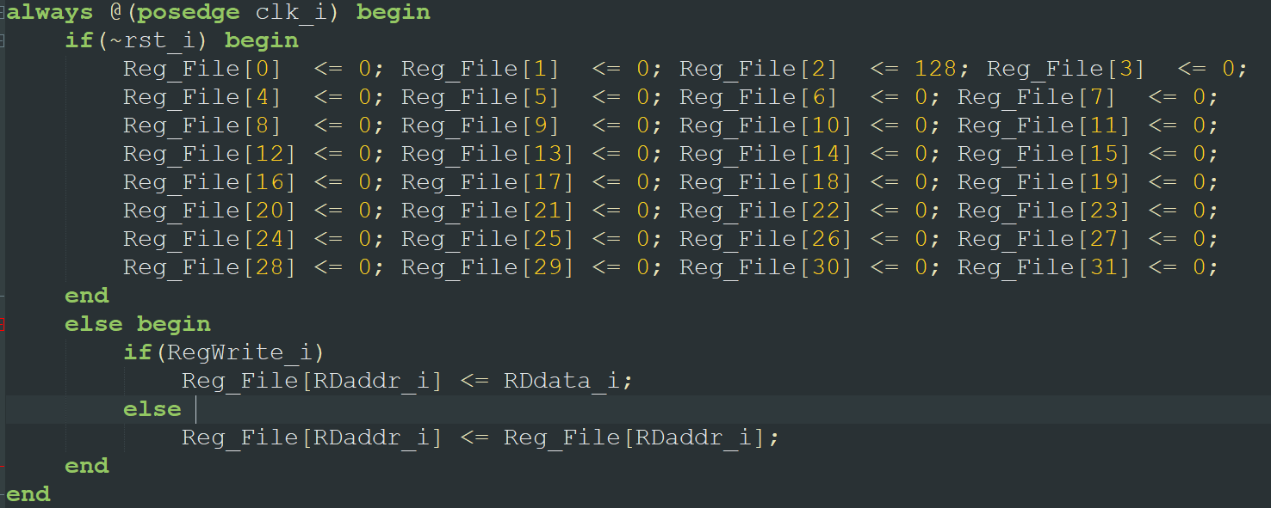
Register File(Provided)
byte
Stack pointer
addi r5,r0,5 //r5=5
addi r2, r2, -4 //r2=128-4=124
sw r5, 0(r2) // store r5 to 124+0
addi r2, r2, 4 // r2=124+4=128
8’d0 , 8’d0, 8’d0, 8’d5

Slide 8
Top Module (Simple_Single_Cycle.v)
Remember to connect the wire between modules in Simple_Single_Cycle.v
Please remember to implement PCSrc for branch instruction.

Slide 9
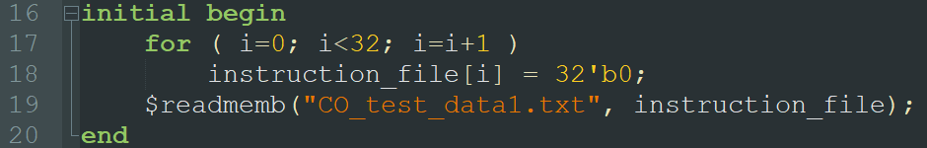
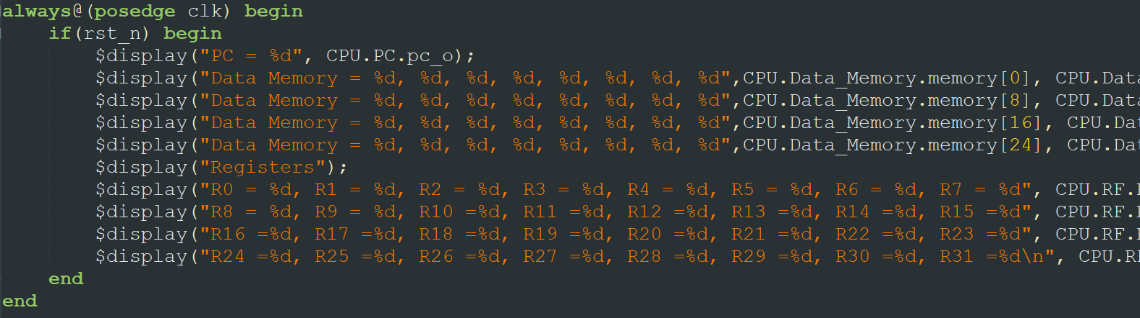
Testbench
2 test cases (CO_test_data1.txt & CO_test_data2.txt.)
Need to manual change by yourself
Edit line 19 in the file “Instr_Memory.v”
Notes:
目前作業有什麼問題？

Slide 10
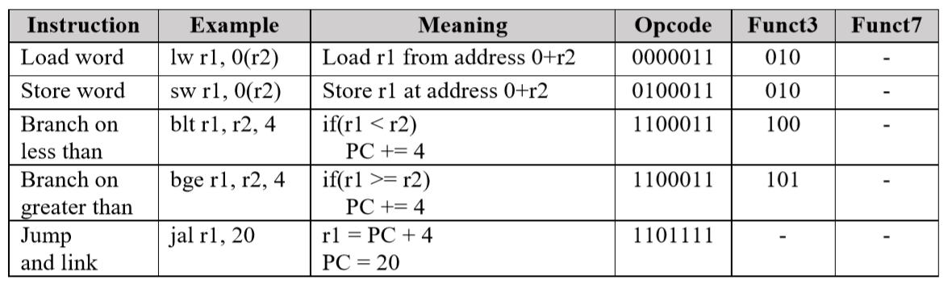
Basic Instruction set (60%)
// ra

Slide 11
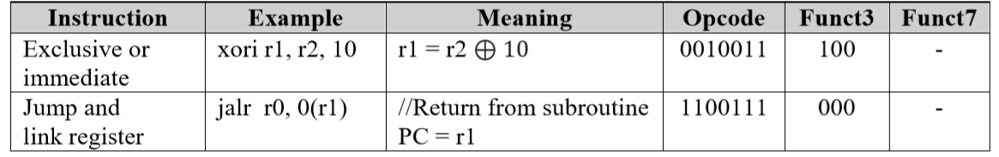
Advance set (20%)
//ret

Slide 12
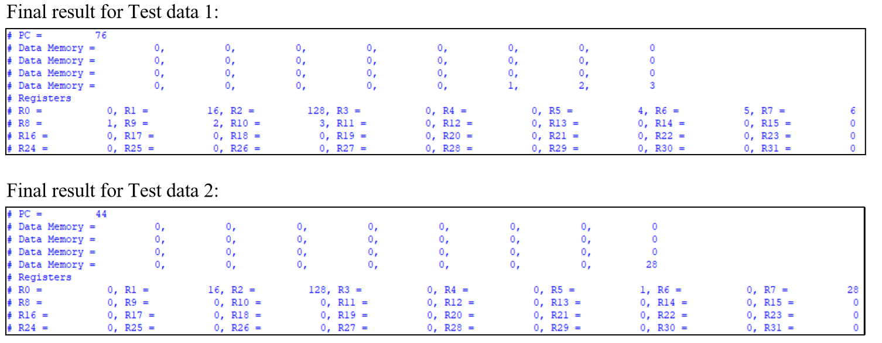
Result

Slide 13
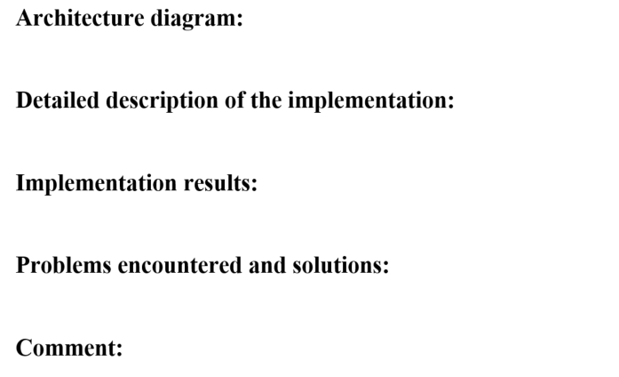
Report

Slide 14
If you have any problems about the specification,
Please contact TA as soon as possible
Contact:
鄭俊賢 petertay1996.cs08g@nctu.edu.tw
Notes:
https://docs.google.com/spreadsheets/d/1ZUCVMoT-TsYwq-XjuQmA8R_mjxXebLykivcohCnJsTE/edit?usp=sharing

